Slide 1
Signal Processing on Databases
Jeremy Kepner
Lecture 5: Perfect Power Law Graphs: Generation, Sampling, Construction, and Fitting
This work is supported by the Intelligence Advanced Research Projects Activity (IARPA) via Air Force Contract FA8721-05-C-0002. The U.S. Government is authorized to reproduce and distribute reprints for Governmental purposes notwithstanding any copyright annotation thereon. Disclaimer: The views and conclusions contained herein are those of the authors and should not be interpreted as necessarily representing the official policies or endorsements, either expressed or implied, of IARPA or the U.S. Government.
This work is sponsored by the Department of the Air Force under Air Force Contract #FA8721-05-C-0002. Opinions, interpretations, recommendations and conclusions are those of the authors and are not necessarily endorsed by the United States Government.
Notes:
1
1
Title Slide

Slide 2
Outline
Introduction
Sampling
Sub-sampling
Joint Distribution
Reuter’s Data
Summary
Detection Theory
Power Law Definition
Degree Construction
Edge Construction
Fitting: α, N, M
Example
Notes:
Outline slide

Slide 3
Goals
Develop a background model for graphs based on “perfect” power law
Examine effects of sampling such a power law
Develop techniques for comparing real data with a power law model
Use power law model to measure deviations from background in real data
Notes:
Goal of talk is to demonstrate a perfect power law model for comparing with measured data.

Slide 4
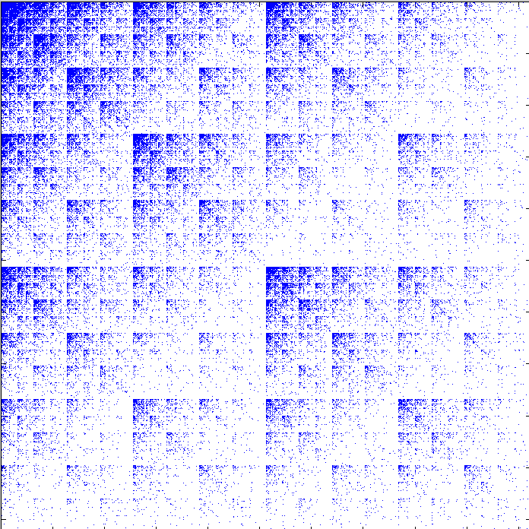
Detection Theory
DETECTION OF SIGNAL IN NOISE
DETECTION OF SUBGRAPHS IN GRAPHS
Example subgraph of interest:
Fully connected (complete)
THRESHOLD
SIGNAL
NOISE
SIGNAL
H₀
H₁
NOISE
N-D SPACE
ASSUMPTIONS
Background (noise) statistics
Foreground (signal) statistics
Foreground/background separation
Model ≈ reality
Example background model:
Powerlaw graph
Can we construct a background model based on power law degree distribution?
Notes:
Subgraph detection challenges: longer integration period
Knowledge extraction can be thought of a detection problem
-Many techniques can be applied (many techniques can be thought of in this context)
-One of the key challenges is finding the right model

Slide 5
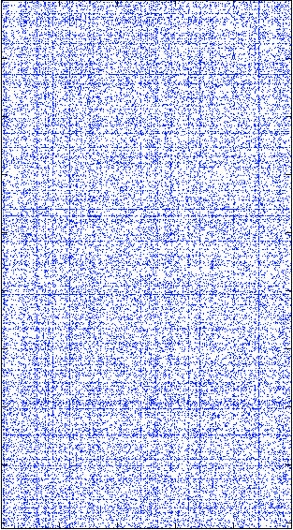
“Perfect” Power Law Matrix Definition
Adjacency/Incidence
Matrix
Vertex Out Degree
Distribution
N_{in}
10⁵
10⁴
10³
10²
10¹
10⁰
Vertex In Degree
Distribution
10³
10²
10¹
10⁰
A
-α_{out}
n(d_{out})
number of vertices
n(d_{in})
number of vertices
-α_{in}
N_{out}
M = ΣA
edges
10⁰ 10¹ 10² 10³ 10⁴ 10⁵
10⁰ 10¹ 10² 10³
in degree, d_{in}
out degree, d_{out}
Graph represented as a rectangular sparse matrix
Can be undirected, multi-edged, self-loops, disconnected, hyper edges, …
Out/in degree distributions are independent first order statistics
Only constraint: Σ n(d_{out}) d_{out} = Σ n(d_{in}) d_{in} = M
Notes:
Power law data are degree distributions on both the rows and the columns.

Slide 6
Power Law Distribution Construction
n₁
1
Perfect power law matlab code
function [di ni] = PPL(alpha,dmax,Nd)
logdi = (0:Nd) * log(dmax) / Nd;
di = unique(round(exp(logdi)));
logni = alpha * (log(dmax) - log(di));
ni = round(exp(logni));
Parameters
alpha = slope
dmax = largest degree vertex
Nd = number of bins (before unique)
n(d_{i}) = n₁/d_{i}^{α}
1 2 3 … 8 16 32 … d_{max}
integer logarithmic
Simple algorithm naturally generates perfect power law
Smooth transition from integer to logarithmic bins
“Poor man’s” slope estimator: α = log(n₁)/log(d_{max})
Notes:
Simple algorithm can be used to construct a perfect power law distribution.

Slide 7
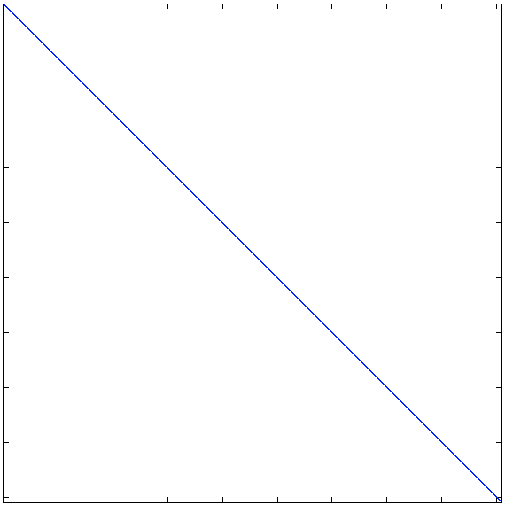
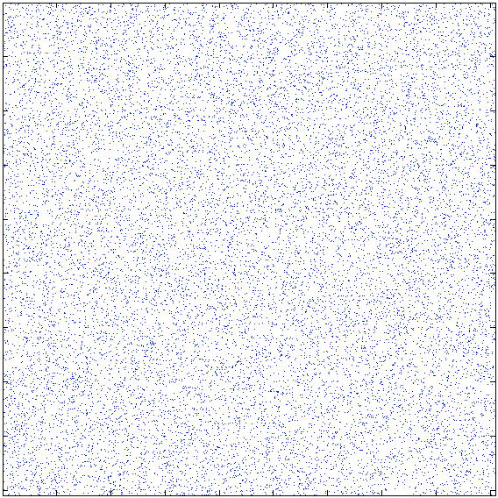
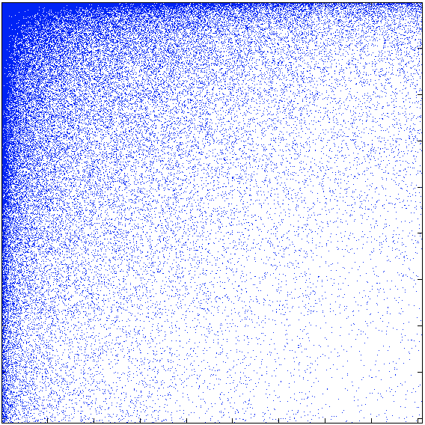
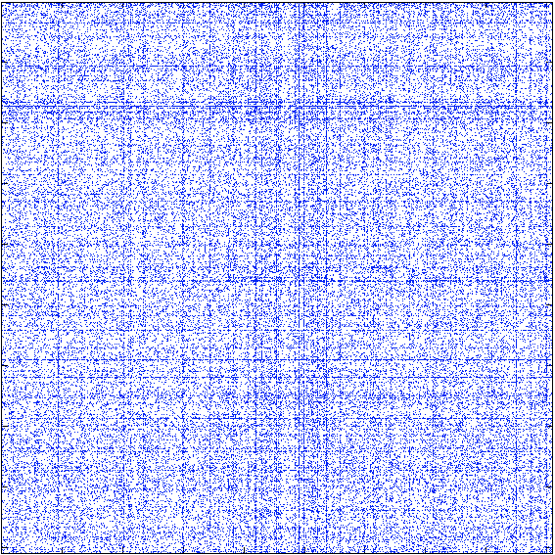
Power Law Edge Construction
random vertex labels
Power law vertex list matlab code
function v = PowerLawEdges(di,ni);
A1 = sparse(1:numel(di),ni,di);
A2 = fliplr(cumsum(fliplr(A1),2));
[tmp tmp d] = find(A2);
A3 = sparse(1:numel(d),d,1);
A4 = fliplr(cumsum(fliplr(A3),2));
[v tmp tmp] = find(A4);
Degree distribution independent of
Vertex labels
Edge pairing
Edge order
random edge pairs
Algorithm generates list of vertices corresponding to any distribution
All other aspects of graph can be set based on desired properties
Notes:
Degree distribution on rows or columns does not constrain how these are connected or the order in which they are created.

Slide 8
Fitting α, N, M
Allowed N and M for α = 1.3
Power law model works for any
α > 0, d_{max} > 1, N_{d} > 1
Desire distribution that fits
α, N, M
Can invert formulas
N = Σ_{i} n(d_{i})
M = Σ_{i} n(d_{i}) d_{i}
Highly non-linear; requires a combination of
Exhaustive search, simulated annealing, and Broyden’s algorithm
M_{max}
M
M_{min}
N
Given α, N, M can solve for N_{d} and d_{max}
Not all combinations of α, N, M are consistent with power law
Notes:
Can fit perfect power law to a real distribution using non-linear fitting techniques.

Slide 9
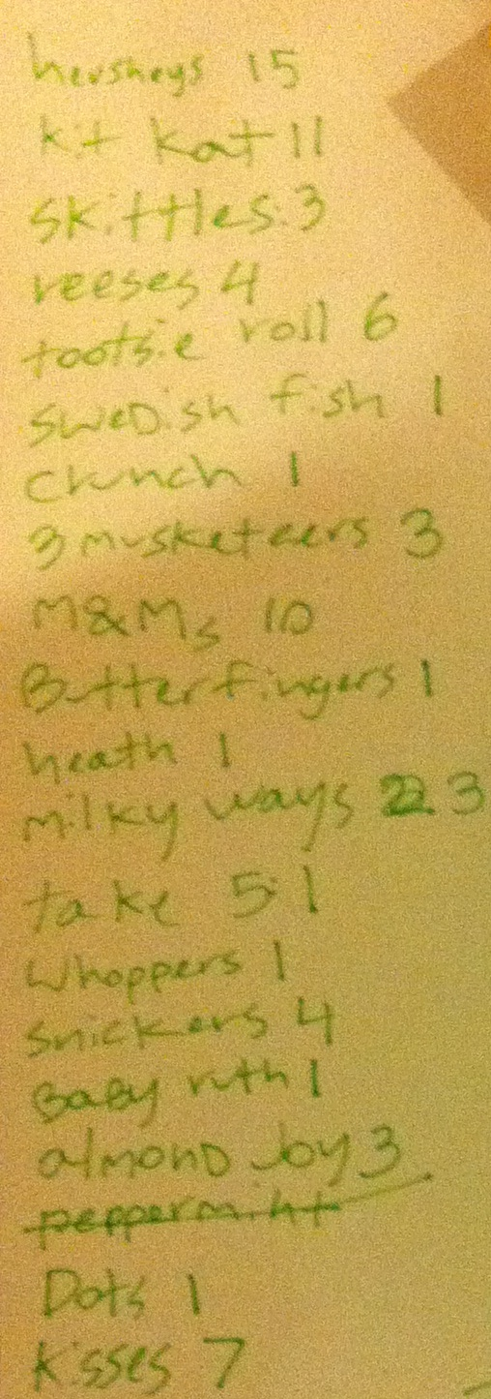
Example: Halloween Candy
Distribution parameters
M = 77
N = 19
M/N = 4.1
n₁ = 8
d_{max} = 15
α = 0.77
Fit parameters
M = 77
N = 21
M/N = 3.7
Procedure
Estimate parameters from data
Determine if viable power law fit
Rebin measured to power law and compare
Notes:
Power law distribution can be found in every day situations.

Slide 10
Outline
Introduction
Sampling
Sub-sampling
Joint Distribution
Reuter’s Data
Summary
Graph construction
Graphs from E’ * E
Edge ordering and densification
Notes:
Outline slide

Slide 11
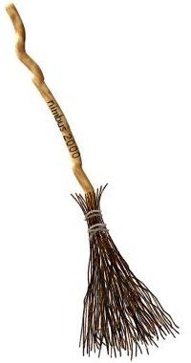
Graph Construction Effects
Generate a perfect power law NxN randomize adjacency matrix A
α = 1.3, d_{max} = 1000, N_{d} = 50
N = 18K, M = 84K
Make undirected, unweighted, with no self-loops
A = triu(A + A’);
A = double(logical(A));
A = A - diag(diag(A));
count
degree
Graph theory best for undirected, unweighted graphs with no self-loops
Often “clean up” real data to apply graph theory results
Process mimics “bent broom” distribution seen in real data sets
Notes:
Cleaning up data can create non-linearities in degree distribution.

Slide 12
Power Law Recovery
Procedure
Compute α, N, M from measured
Fit perfect power law to these parameters
Rebin measured data using perfect power law degree bins
count
degree
Perfect power law fit to “cleaned up” graph can recover much of the shape of the original distribution
Notes:
Fitting clean up data and rebinning can recover original distribution.

Slide 13
Correlation Construction Effects
Generate a perfect power law NxN randomize incidence matrix E
α = 1.3, d_{max} = 1000, N_{d} = 50
N = 18K, M = 84K
Make unweighted and use to form correlation matrix A with no self-loops
E = double(logical(E));
A = triu(E’ * E);
A = A - diag(diag(A));
count
degree
Correlation graph construction from incidence matrix results in a “bent broom” distribution that strongly resembles a power law
Notes:
Correlation matrix appears to generate a power law.

Slide 14

Power Law Lost
Procedure
Compute α, N, M from measured
Fit perfect power law to these parameters
Rebin measured data using perfect power law degree bins
count
degree
Perfect power law fit to correlation shows non-power law shape
Reveals “witches nose” distribution
Notes:
Rebinning data shows that the distribution has a bump in it.

Slide 15
Power Law Preserved
In degree is power law
α = 1.3, d_{max} = 1000, N_{d} = 50
N = 18K, M = 84K
Out degree is constant
N = 16K, M = 84K
Edges/row = 5 (exactly)
Make unweighted and use to form correlation matrix A with no self-loops
count
degree
Uniform distribution on correlated dimension preserves power law shape
Notes:
If the inner dimension is uniform, then correlation produces a power a law.

Slide 16
Edge Ordering: Densification
Compute M/N cumulatively and piecewise for 2 orderings
Linear
Random
By definition M/N goes from 1 to infinity for finite N
Elimination of multi-edges reduces M and causes M/N to grow more slowly
Linear
random
cumulative
random
“Densification” is the observation that M/N increases with N
Densification is a natural byproduct of randomly drawing edges from a power law distribution
Linear ordering has constant M/N
Notes:
Order of edges is a free parameter. Different orders create different densification trajectories.

Slide 17
Edge Ordering: Power Law Exponent (α)
Compute α cumulatively and piecewise for 2 orderings
Linear
Random
Edge ordering and sampling have large effect on the power law exponent
random
random
cumulative
linear
cumulative
linear
Power law exponent is fundamental to distribution
Strongly dependent on edge ordering and sample size
Notes:
Power law exponent of data also has different trajectories based on edge ordering.

Slide 18
Outline
Introduction
Sampling
Sub-sampling
Joint Distribution
Reuter’s Data
Summary
Notes:
Outline slide

Slide 19
Sub-Sampling Challenge
Anomaly detection requires good estimates of background
Traversing entire data sets to compute background counts is increasingly prohibitive
Can be done at ingest, but often is not
Can background be accurately estimated from a sub-sample of the entire data set?
Notes:
Sub-sampling is a key technique for analyzing large quantities of data. It is not clear how to properly sub-sample a power law distribution.

Slide 20
Sampling a Power Law
Generate power law
Select fraction of edges
Whole distribution
1/40 sample
Notes:
Construct a sample by creating a perfect power law and selecting 1/40 of the edges.

Slide 21
Linear Degree Estimate
Divide measured degree by fraction
Accurate for high degree
Overestimates low degree
Can we do better?
Whole distribution
Linear estimate
Notes:
Linear estimate multiples measured degree by ratio. Overestimates the degree of low degree vertices.

Slide 22
Non-Linear Degree Estimate
Assume power law input
Create non-linear estimate
Matches median degree
Whole distribution
Non-Linear estimate
Notes:
Non-linear estimated can compensate by targeting the median the degree of low degree vertices.

Slide 23
Sub-Sampling Formula
f = fraction of total edges sampled
n₁ = # of vertices of degree 1
d_{max} = maximum degree
Allowed slope: ln(n₁)/ln(d_{max}/f) < α < ln(n₁)/ln(d_{max})
Cumulative distribution
P(α,d) = (f^{1-α} d_{max}^{α} / n₁) Σ_{i<d} i^{1-α} e^{-fi}
Find α* such that P(α*,∞) = 1
Find d_{50%} such that P(α*,d_{50%}) = ½
Compute K = 1/(1 + ln(d_{50%})/ln(f))
Non-linear estimate of true degree of vertex v from sample d(v)
d(v) = d(v) / f^{1-1/(K d(v))}
Notes:
Sub-sampling correction relays on quantile fitting of Poisson distribution.

Slide 24
Outline
Introduction
Sampling
Sub-sampling
Joint Distribution
Reuter’s Data
Summary
Measured
Expected
Time Evolution
Notes:
Outline slide

Slide 25
Joint Distribution Definitions
Label each vertex by degree
Count number of edges from d_{out} to d_{in}: n(d_{out},d_{in})
Rebin based on perfect power law model
Can compare measured vs. expected
Power law model allows precise quantitative comparison of observed data with a model
Notes:
Degree can be used a vertex label as to compress data.

Slide 26
Measured Joint Distribution
Measured
log₁₀(n)
Measured Rebin
log₁₀(n)
d_{out}
d_{out}
d_{in}
d_{in}
Measured distribution is highly sparse
Rebinning based on power law fit degree bins makes most bins not empty
Notes:
Rebinned data concentrates bins to where the data is.

Slide 27
Expected Joint Distribution
Expected
log₁₀(n)
Expected Rebin
log₁₀(n)
d_{out}
d_{out}
d_{in}
d_{in}
Using n(d_{out}) and n(d_{in}) can compute expected n(d_{out},d_{in}) = n(d_{out}) x n(d_{in})/M
Notes:
Can computed expected distribution in both original and rebinned data.

Slide 28
Measured/Expected Joint Distribution
Measured/Expected
log₁₀(n)
Measured/Expected Rebin
log₁₀(n)
d_{out}
d_{out}
d_{in}
d_{in}
Ratio of measured to expected highlights surpluses , deficits , typical edges
Binning reduces Poisson fluctuations and allows for more meaningful selection
Notes:
Rebinned data shows that it is consistent with expected distributions.

Slide 29
Measured/Expected Joint Distribution
Measured
Measured Rebin
Measured/Expected
Measured/Expected Rebin
Ratio of measured to expected highlights surpluses , deficits , typical edges
Binning reduces Poisson fluctuations and allows for more meaningful selection
Notes:
Ratio test highlight high and low points in the distribution.

Slide 30
Selected Edges
Out Vertex
In Vertex
Ratio of measured to expected highlights surpluses , deficits , typical edges
Can use to select actual edges that correspond to fluctuations
Notes:
High and low bins can then be used to find specific edges in the data.

Slide 31
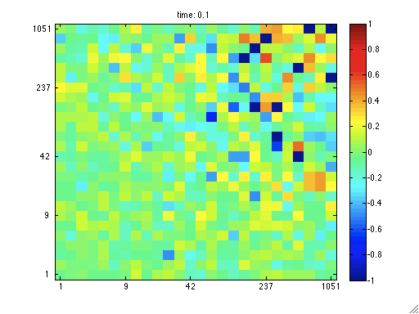
Measured/Expected Random Edge Order
Measured Rebin/Expected Rebin
log₁₀(n)
d_{out}
d_{in}
Ratio of measured to expected highlights unusual correlations
Notes:
Joint distribution can be displayed over time. Random edge ordering looks uniform.

Slide 32
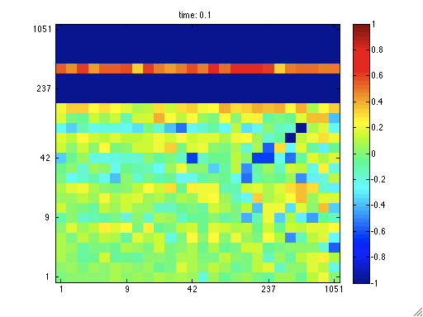
Measured/Expected Linear Edge Order
Measured Rebin/Expected Rebin
log₁₀(n)
d_{out}
d_{in}
Ratio of measured to expected highlights unusual correlations
Notes:
Linear edge ordering show that when high degree nodes show up they appear unusual.

Slide 33
Outline
Introduction
Sampling
Sub-sampling
Joint Distribution
Reuter’s Data
Summary
Degree distributions
Correlation Graph
Densification
Joint distributions
Notes:
Outline slide

Slide 34
Reuter’s Incidence Matrix
Entities extracted from Reuter’s Corpus
E(i,j) = # times entity appeared in document
N_{doc} = 797677
N_{ent} = 47576
M = 6132286
Four entity classes with different statistics
LOCATION
ORGANZATION
PERSON
TIME
LOCATION
ORGANIZTION
PERSON
TIME
E
DOCUMENT
Fit power law model to each entity class
Notes:
Reuter’s data can be used to test perfect power law mode.

Slide 35
E(:,LOCATION) Degree Distribution
 | M | N | M/N | α | M_{fit} | N_{fit} | M_{fit}/N_{fit}
Document | 4694260 | 796414 | 5.89 | 1.70 | 4699280 | 811364 | 5.79
Entity | 4694260 | 1786 | 2628 | 0.47 | 4696734 | 3680 | 1276
Notes:
Location distribution is not a good fit to data.

Slide 36
E(:,ORGANIZATION) Degree Distribution
 | M | N | M/N | α | M_{fit} | N_{fit} | M_{fit}/N_{fit}
Document | 192390 | 69919 | 2.75 | 2.22 | 185800 | 85835 | 2.16
Entity | 192390 | 141 | 1364 | 0.32 | 191943 | 205 | 936
Notes:
Organization distribution is a good fit to data.

Slide 37
E(:,PERSON) Degree Distribution
 | M | N | M/N | α | M_{fit} | N_{fit} | M_{fit}/N_{fit}
Document | 299333 | 170069 | 1.76 | 1.92 | 302478 | 170066 | 1.78
Entity | 299333 | 37191 | 8.05 | 1.21 | 299748 | 37449 | 8.00
Notes:
Person distribution is a good fit to data.

Slide 38
E(:,TIME) Degree Distribution
 | M | N | M/N | α | M_{fit} | N_{fit} | M_{fit}/N_{fit}
Document | 946299 | 797677 | 1.19 | 2.37 | 944653 | 797734 | 1.18
Entity | 946299 | 8444 | 112 | 0.83 | 947711 | 19848 | 47.7
Notes:
Time distribution is not a good fit to data.

Slide 39
E(:,PERSON)^{t} x E(:,PERSON)
Procedure
Make unweighted and use to form correlation matrix A with no self-loops
E = double(logical(E));
A = triu(E’ * E);
A = A - diag(diag(A));
Perfect power law fit to correlation shows non-power law shape
Reveals “witches nose” distribution
Notes:
Person/person correlation shows bump distribution.

Slide 40
E(:,TIME)^{t} x E(:,TIME)
Procedure
Make unweighted and use to form correlation matrix A with no self-loops
E = double(logical(E));
A = triu(E’ * E);
A = A - diag(diag(A));
Perfect power law fit to correlation shows non-power law shape
Reveals “witches nose” distribution
Notes:
Time/time correlation shows bump distribution.

Slide 41
Document Densification
Constant M/N consistent with sequential ordering of documents
Notes:
Document densification consistent with model.

Slide 42
Entity Densification
Increasing M/N consistent with random ordering of entities
Notes:
Entity densification consistent with model.

Slide 43
Document Power Law Exponent (α)
Increasing α consistent with sequential ordering of documents
Notes:
Document power law exponent consistent with model.

Slide 44
Entity Power Law Exponent (α)
Decreasing α consistent with random ordering of entities
Notes:
Entity power law exponent consistent with model.

Slide 45
E(:,LOCATION) Joint Distribution
log₁₀(n)
log₁₀(n)
log₁₀(n)
Ratio of measured to expected highlights surpluses , deficits , typical edges
Notes:
Measured and expected distributions agree.

Slide 46
E(:,ORGANIZATION) Joint Distribution
log₁₀(n)
log₁₀(n)
log₁₀(n)
Ratio of measured to expected highlights surpluses , deficits , typical edges
Notes:
Measured and expected distributions agree.

Slide 47
E(:,PERSON) Joint Distribution
log₁₀(n)
log₁₀(n)
log₁₀(n)
Ratio of measured to expected highlights surpluses , deficits , typical edges
Notes:
Measured and expected distributions agree.

Slide 48
E(:,TIME) Joint Distribution
log₁₀(n)
log₁₀(n)
log₁₀(n)
Ratio of measured to expected highlights surpluses , deficits , typical edges
Notes:
Measured and expected distributions differ.

Slide 49
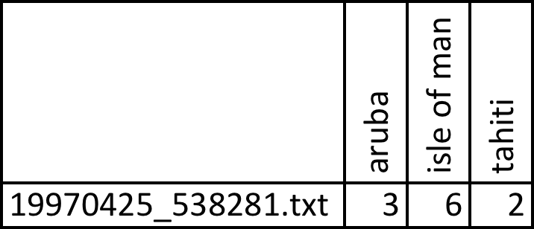
Selected Edges E(:,LOCATION)
Typical
Deficit
Surplus
Document
(very high degree)
Entity (medium degree)
1, 2, 3, …
All ~1
Document (low degree)
Document (very low degree)
Entity(medium degree)
Entity (medium degree)
Highlights anomalous edges
Notes:
High/low bins can be used to find specific edges.

Slide 50
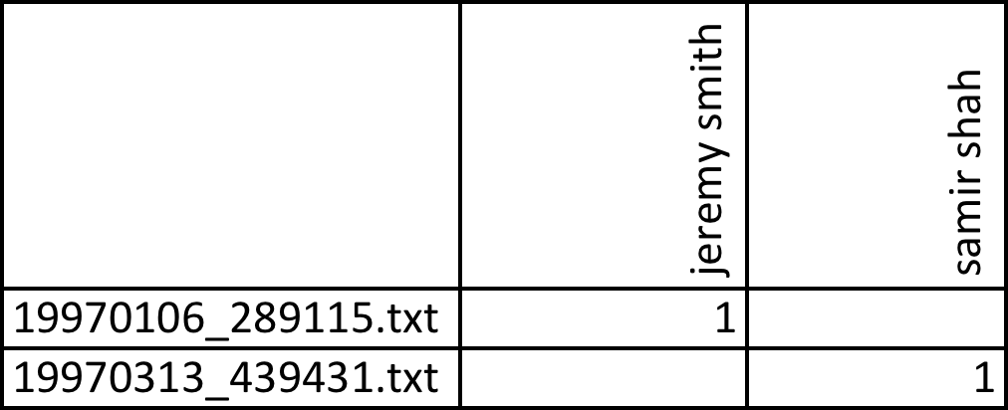
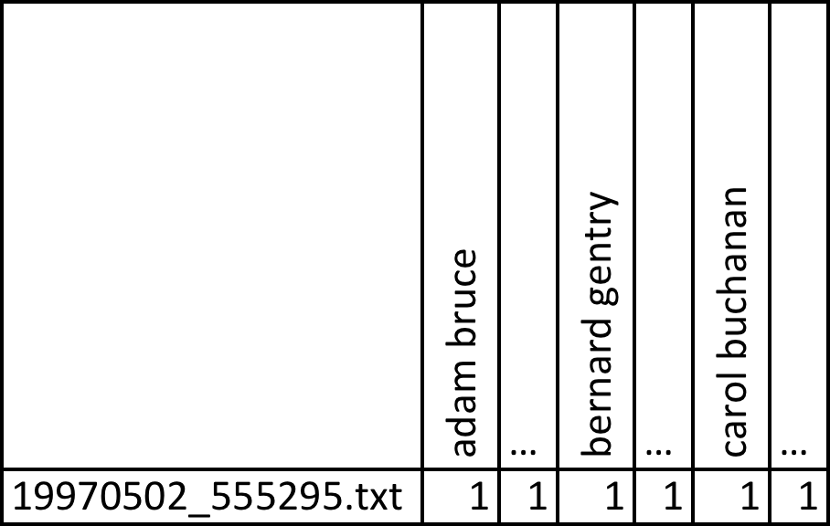
Selected Edges E(:,PERSON)
Typical
Deficit
Document
(low degree)
Entity (high degree)
Surplus
Document (low degree)
All ~1
Document
(high degree)
Entity (low degree)
Entity(high degree)
Highlights anomalous edges
Notes:
High/low bins can be used to find specific edges.

Slide 51
Summary
Develop a background model for graphs based on “perfect” power law
Can be done via simple heuristic
Reproduces much of observed phenomena
Examine effects of sampling such a power law
Lossy, non-linear transformation of graph construction mirrors many observed phenomena
Traditional sampling approaches significantly overestimate the probability of low degree vertices
Assuming a power law distribution it is possible to construct a simple non-linear estimate that is more accurate
Develop techniques for comparing real data with a power law model
Can fit perfect power-law to observed data
Provided binning for statistical tests
Use power law model to measure deviations from background in real data
Can find typical, surplus and deficit edges
Notes:
Summary.

Slide 52
Example Code & Assignment
Example Code
D4Muser_share/Examples/2Apps/3PerfectPowerLaw
Assignment 4
Compute the degree distributions of cross-correlations you found in Assignment 3
Explain the meaning of each degree distriubtion
Notes:
Example code and homework.

